Slide 1

The Couch Potato Web App
Chris Markel
Notes:
Hello everyone, my name is Chris Markel, and today I'm excited to present to you 'The Couch Potato Web App'. This isn't just another e-commerce platform; it's a meticulously crafted solution designed for those who prioritize comfort and relaxation in their lives.

Slide 2

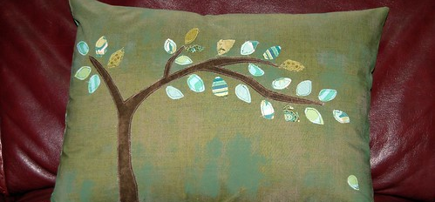

Introduction
This Photo by Unknown Author is licensed under CC BY
Purpose: The Couch Potato Web App is a dedicated e-commerce platform designed to cater to the modern consumer's desire for comfort and relaxation. In today's fast-paced world, the need for products that amplify comfort has never been greater. Our platform bridges this gap, offering a curated selection of products that promise relaxation and ease.
Vision: To become the go-to online destination for consumers seeking products that enhance their relaxation and leisure time. We aim to provide a seamless shopping experience, ensuring that every user finds their perfect comfort product.
Commitment: Beyond just a shopping platform, The Couch Potato Web App is a commitment. A commitment to quality, sustainability, and ethically sourced products. Every product on our platform is vetted to ensure it meets our stringent quality standards.
This Photo by Unknown Author is licensed under CC BY-NC
This Photo by Unknown Author is licensed under CC BY-SA-NC
Notes:
The Couch Potato Web App is more than just a name; it represents our core philosophy. In today's fast-paced world, we often forget the importance of taking a moment to relax and unwind. Our platform is dedicated to offering products that amplify comfort, ensuring that every user finds their perfect relaxation companion. We've integrated a seamless, user-friendly interface, fortified transactions, and a diverse array of comfort products. While we have plans for future enhancements, including a recommendation engine, our current core functionalities promise robust performance, ensuring satisfaction and reliability for all users.

Slide 3

Purpose of the Couch Potato Web App
Simplify online shopping for comfort products.
Offer a user-friendly interface for a seamless shopping experience.
Provide a platform that's responsive across devices.
Future enhancements: Recommendation engine for personalized shopping.
Notes:
Good [morning/afternoon/evening], everyone. The primary purpose of The Couch Potato Web App is to simplify the online shopping experience for users seeking comfort products. We've designed it with a user-friendly interface that ensures a seamless shopping journey. Moreover, our platform is built to be responsive across various devices, ensuring that users can shop anytime, anywhere. While our current version offers core functionalities, we have plans for future enhancements, including a recommendation engine for a more personalized shopping experience.

Slide 4

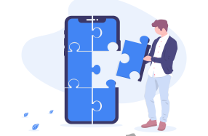
Project Requirements
This Photo by Unknown Author is licensed under CC BY-NC
User Registration and Authentication
Product Browsing
Shopping Cart Management
Category Management
Responsive Design
Notes:
Our project had a set of core requirements that we aimed to fulfill. Firstly, we wanted to ensure that users could easily register and authenticate themselves. This is crucial for a personalized shopping experience. Next, we focused on product browsing, allowing users to easily navigate and find products they're interested in. Additionally, we implemented a shopping cart management system and category management to organize products efficiently. Lastly, a responsive design was a must-have to cater to users on various devices.

Slide 5
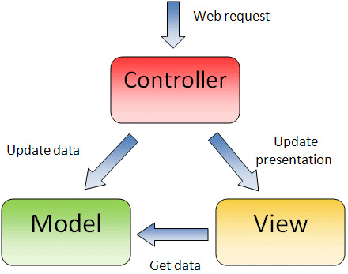
Design Approach
User-Centric Design
Modular Architecture
Scalable Database Design
Intuitive Navigation
This Photo by Unknown Author is licensed under CC BY-SA
Notes:
Our application is built on the robust Spring Boot framework, leveraging its MVC (Model-View-Controller) design pattern. This design ensures a clear separation of concerns, making our application modular and easily maintainable. At the heart of our backend is Java, a versatile language known for its scalability and efficiency.
For the frontend, we've chosen Thymeleaf templates. Thymeleaf's seamless integration with Spring Boot allows us to create dynamic web pages that offer a rich user experience. To ensure our application's user interface is accessible and looks great on all devices, we've incorporated Bootstrap, a framework renowned for its responsive design capabilities.
On the data side, we've opted for MySQL, a reliable and widely-used relational database system. It efficiently handles our data storage and retrieval needs, ensuring smooth operations. We've also implemented security configurations to safeguard our application from unauthorized access and potential threats.
In terms of configuration, we've set up various settings, including database connection details, in our configuration files. This ensures our application can adapt and run smoothly in different environments.

Slide 6
Table
 | Category 1 | Category 2 | Category 3 | Category 4
Item 1 | 4.5 | 2.3 | 1.7 | 5
Item 2 | 3.2 | 5.1 | 4.4 | 3
Item 3 | 2.1 | 1.7 | 2.5 | 2.8
Item 4 | 4.5 | 2.2 | 1.7 | 7

Slide 7

The way to get started is to quit talking and begin doing.
Walt Disney

Slide 8
Team
Name Title
Name Title
Name Title
Name Title

Slide 9
Timeline
Title
To start a presentation, go to the Slide Show tab, and select From Beginning.
Title
To display Presenter view, in Slide Show view, on the control bar at the bottom left select the three dots, and then Show Presenter View.
Title
During your presentation, the speaker notes are visible on your monitor, but aren't visible to the audience.
Title
Title
The Notes pane is a box that appears below each slide. Tap it to add notes.
If you don’t see the Notes pane or it is completely minimized, click Notes on the task bar across the bottom of the PowerPoint window.

Slide 10
Content
Subtitle
Subtitle
Add text, images, art, and videos.
Add transitions, animations, and motion.
Save to OneDrive, to get to your presentations from your computer, tablet, or phone.
Open the Design Ideas pane for instant slide makeovers.
When we have design ideas, we’ll show them to you right there.

Slide 11
Content three column
Subtitle
Subtitle
Subtitle
Add text, images, art, and videos.
Add transitions, animations, and motion.
Save to OneDrive, to get to your presentations from your computer, tablet, or phone.
Open the Design Ideas pane for instant slide makeovers.
When we have design ideas, we’ll show them to you right there.
This PowerPoint theme uses its own unique set of colors, fonts, and effects to create the overall look and feel of these slides.
PowerPoint has tons of themes to give your presentation just the right personality.

Slide 12


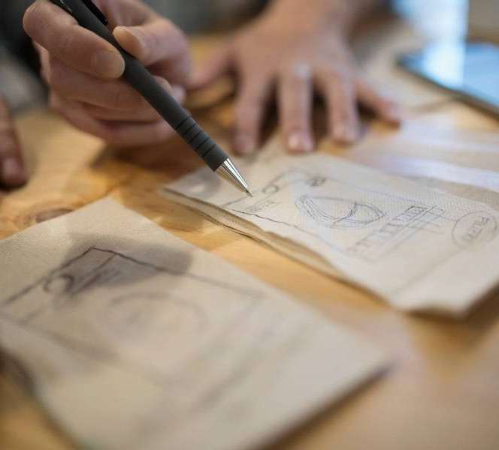
Summary
With PowerPoint, you can create presentations and share your work with others, wherever they are. Type the text you want here to get started. You can also add images, art, and videos on this template. Save to OneDrive and access your presentations from your computer, tablet, or phone. ​

Slide 13

Thank You
Presenter Name
Email
Website

